Slide 1
Sinusoidal modeling
EE6641 Analysis and Synthesis of Audio Signals
Yi-Wen Liu
Nov 3, 2015

Slide 2
Last time: Spectral Estimation
Resolution
Scenario: multiple peaks in the spectrum
Choice of window type and window length
Rule of thumb: Δω = O(1/Δτ)
Accuracy
Scenario: signal in noise
Quadratic interpolation of FFT log-magnitude
Fisher Information and Cramer-Rao lower bounds
Coherent frequency estimation: Δω = O(Δτ^{−3/2})

Slide 3
Today’s agenda
Sinusoidal modeling
Analysis
Formula for QI-FFT
Choice of window
Peak tracking
Synthesis
Applications
Spectral decomposition
(S + N) vs. (S + N + T)
Spectral subtraction

Slide 4
QI-FFT: a fast frequency estimator
Windowing: time-domain multiplication with a shaping function
Zero-padding: append zeros in time ⬄ interpolate in frequency
FFT: apply fast Fourier transform
Peak detection: find every peak
Quadratic interpolation: fit a parabola in log-magnitude
The location of the parabola is the frequency estimate.
Reference: M. Abe and J. Smith, “Design criteria for simple sinusoidal parameter estimation based on quadratic interpolation of FFT magnitude peaks”, (AES 2004)
dB
Hz

Slide 5
A formula for QI-FFT
dB
-1
0
1
k

Slide 6
Example: finding peaks in a spectrum
Peaks can move
Peaks can grow or attenuate
Need to ignore side lobes
But how?

Slide 7
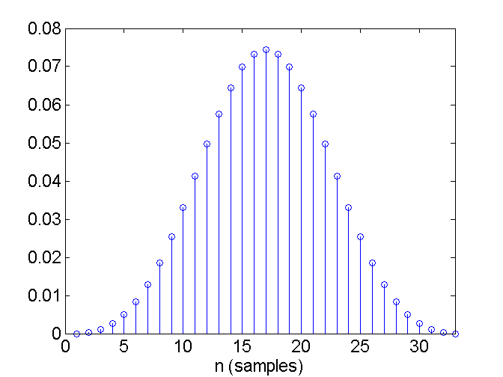
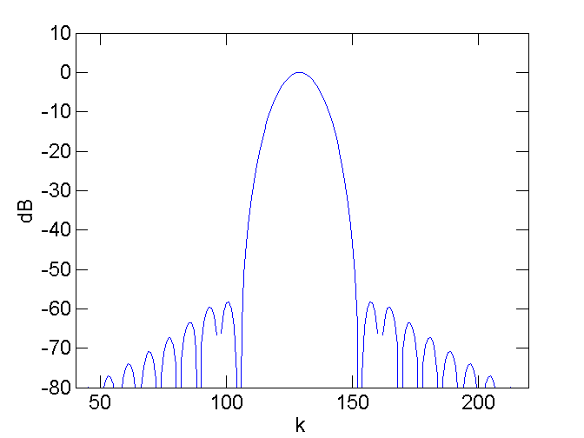
Blackman window has > 50 dB side-lobe suppression
All side lobes beneath the masking threshold.

Slide 8
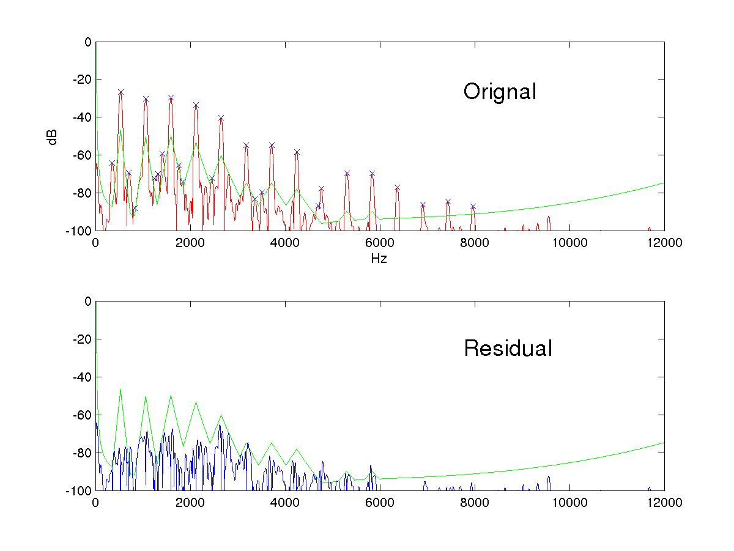
Example: Hann-windowed transform of trumpet sounds
signal spectrum
Masked region
Hz

Slide 9
Psychoacoustic masking
Masking refers to the fact that softer sounds cannot be heard due to the presence of stronger sounds.
Forward masking
Simultaneous
Backward masking
We will cover psychoacoustics later in this semester.

Slide 10
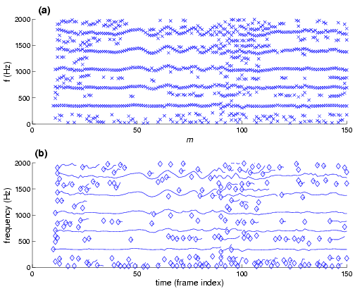
Sinusoidal Modeling: from discrete peaks to trajectories

Slide 11
Trajectory formation
Basic peak tracking involves:
Finding shortest link
Resolving splits
Advanced technique includes
Forbidding large jumps
Transient detection
Highest peak chooses first

Slide 12
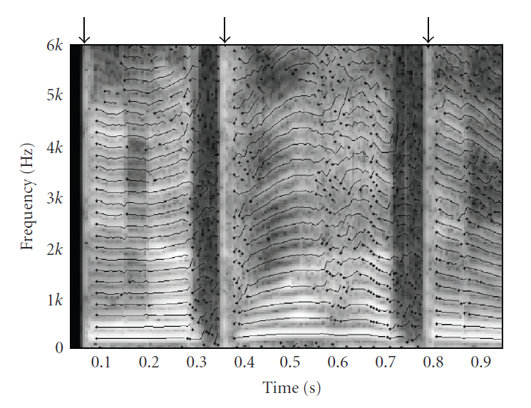
Frequency-trajectories of a speech signal, arrows indicate transient regions

Slide 13
Part II: Synthesis
Sinusoidal modeling
Analysis
Synthesis
Linear-interpolation
Phase continuation
A window-based synthesis method
Spectral decomposition
(S + N) vs. (S + N + T)
Spectral subtraction
Noise modeling (Nov. 16, 23)

Slide 14
Sinusoidal synthesis (ii): the linear interpolation method
……..an amplitude envelope
……..a frequency envelope
A_{m+1}
A[n]
A_{m}
Remark: amplitude can be log
or linear scale.

Slide 15
The linear-interpolation method (cont’d)

Slide 16
From one trajectory to a signal: a window-based method
……..an amplitude envelope
……..a frequency envelope
Synthesis:
Continuous phase updates:
time
A_{m}
hT

Slide 17
summation over all trajectories
time
A_{m}
hT

Slide 18
Applications of sinusoidal modeling
Noise removal/ speech enhancement
Potentials in hearing aids/ cochlear implants
Musical effects:
Pitch shifting/ time warping
Parametric audio coding:
MPEG-4 structured audio
B. Vercoe et al. (1998). “Structured audio: Creation, transmission, and rendering of parametric sound representations,” Proc. IEEE, Vol. 86, No. 5, 922-40.

Slide 19
Part III: Spectral decomposition
Sinusoidal modeling
Analysis
Synthesis
Linear-interpolation
Phase continuation
A window-based synthesis method
Signal decomposition
Spectral subtraction
(S + N) vs. (S + N + T)
Noise modeling (Possible final project idea)

Slide 20
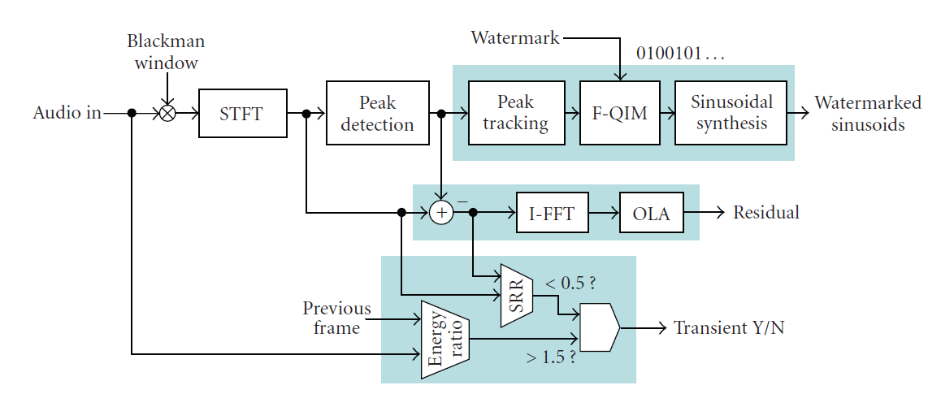
Example: a watermarking system based on signal decomposition (Liu & Smith, 2007)

Slide 21
Sines + Noise + Transient (S+N+T) decomposition
Sinsusoids

Slide 22
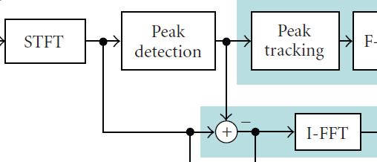
Spectral subtraction
For each peak in the spectrum, do
fit the mainlobe of Blackman window
subtract the mainlobe
Inverse FFT to synthesis the residual (“noise”)

Slide 23
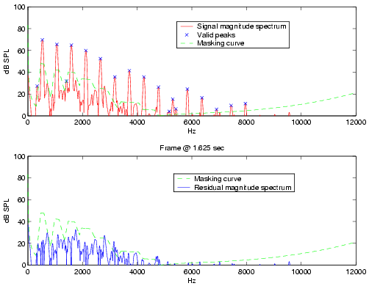
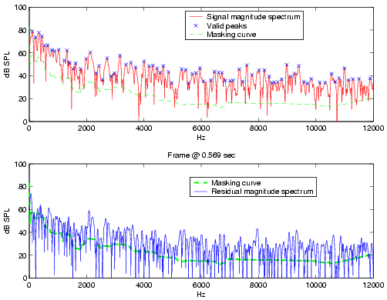
Sines + “noise” decomposition by spectral subtraction
(dB)
100
Signal
Signal
Signal
80
60
40
20
0
2k
4k
6k
8k
10k
(Hz)
0
2k
4k
6k
8k
10k
(Hz)
Residual
Residual
Residual
(a) Trumpet
(b) Dance music
Parametric noise modeling?

Slide 24

Transient detection
Sinsusoids

Slide 25
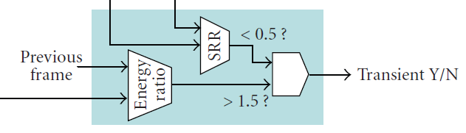
Transient detection: there’s no gold standard
The following is just a heuristic approach
Energy comparison
Sine-to-residual ratio (SRR)

Slide 26
Entering and exiting the transients
Once a transient is detected, sinusoidal model is halted for a period of time.

Slide 27
Possible project ideas
Trajectory formation
Causal implementation for real-time applications
Applications of spectral subtraction
Noise-removal / Speech enhancement
Audio recognition
Sound source segregation
Audio fingerprinting/ watermarking
And so on…

Slide 28


